Slide 1
M&D School…
A Web App for the ones who need special needs to learn …

Slide 2
WHAT’S m&D School?
M&D School provides an education platform for those children who need special needs to learn about something. In India there is a lot of problem in the education sector for deaf and mute. They hardly learn something in school and in effect they lack to communicate with others. This is where M&D school fills the gap, it provides an interacting platform where an user can
: Learn About the Definition and Use of Objects.
:Learn About the Hand Signals Meanings to communicate.
:A User can Also create a Virtual Class for teaching other
mute and deaf persons.

Slide 3
Stacks Used.
For the Front-End Part : HTML
:CSS
:JavaScript
:Reactjs
For the Backend-Part :Nodejs
:Express
:MongoDB

Slide 4
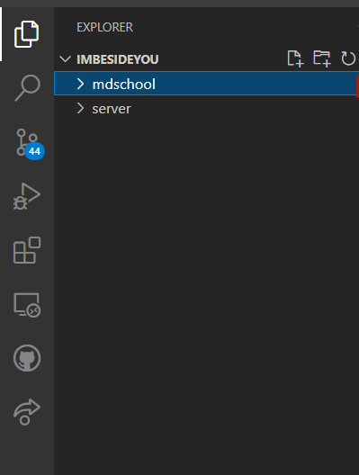
Code Walkthrough
Basically the Code is divided into two parts : The Mdschool Side and The Server Side.
The mdschool Side handles Front-End Part of the Website while the server side handles the backend part.
The App was only built for the
Desktop use. As some people
Still use phones that don’t have
Inbuilt camera.

Slide 5
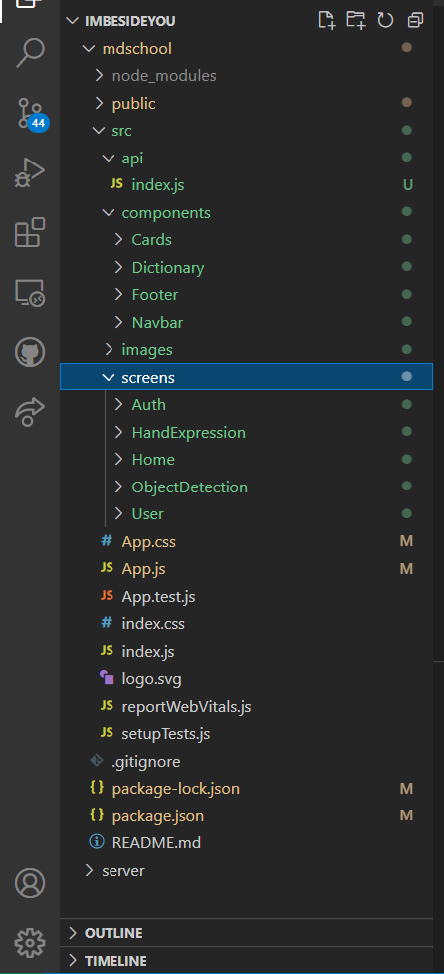
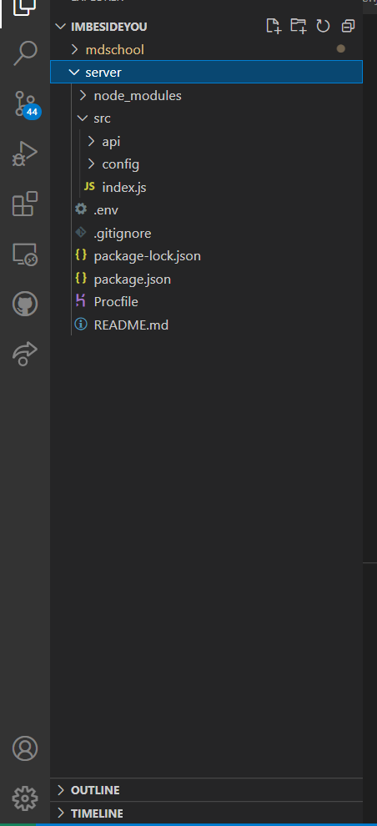
Front-End Part and backend part
For Front End Part REACTJS was used which consisted of the components,screens and images
For Back End Part Nodejs/Express and MongoDB was used which consisted of the user schema, api’s and .env file.

Slide 6
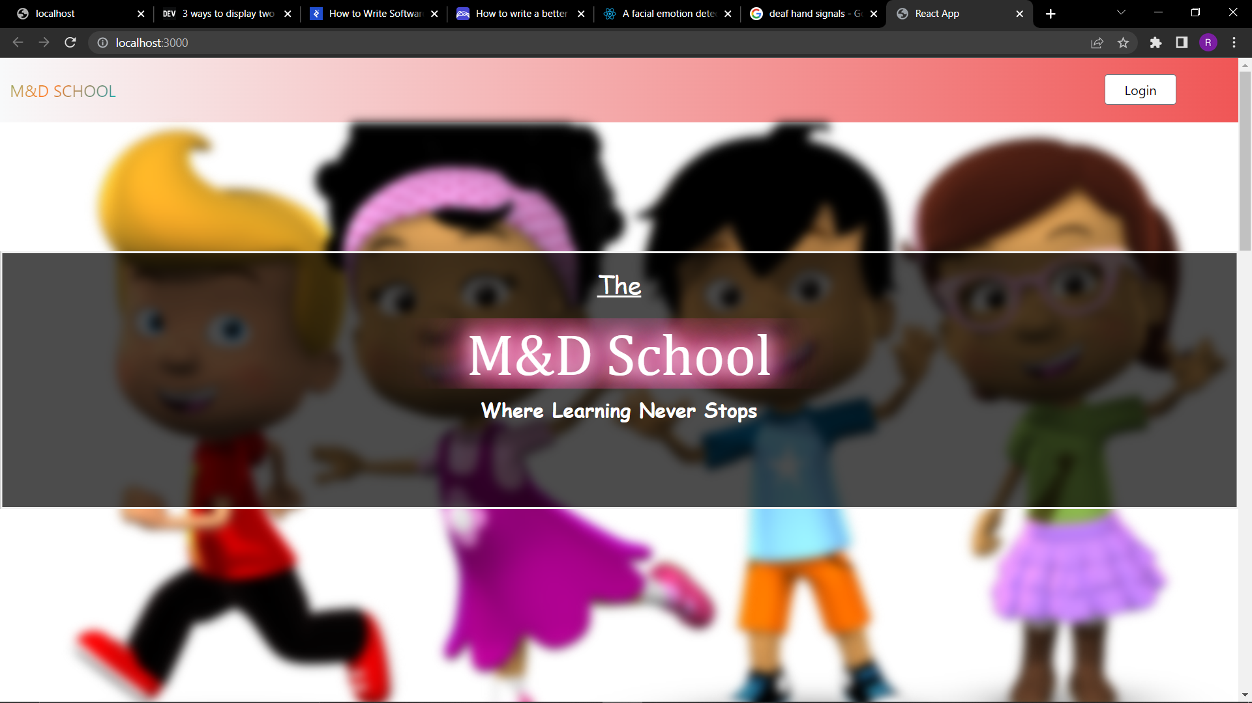
Home page of MDSCHOOL
The UI/UX of the web app was made quite animated, as it was made to make comfort to the user using it.
The Home page consisted of the sections : HeroBanner, About, Learnings, Facts and Footer.

Slide 7
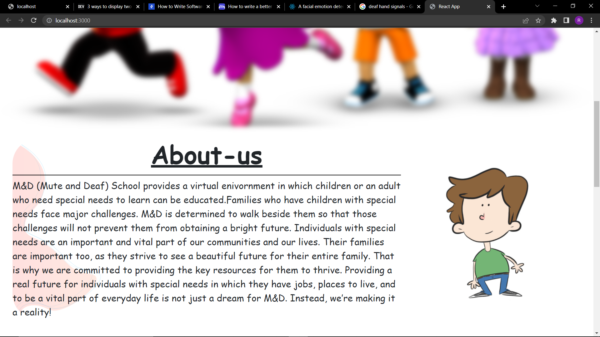
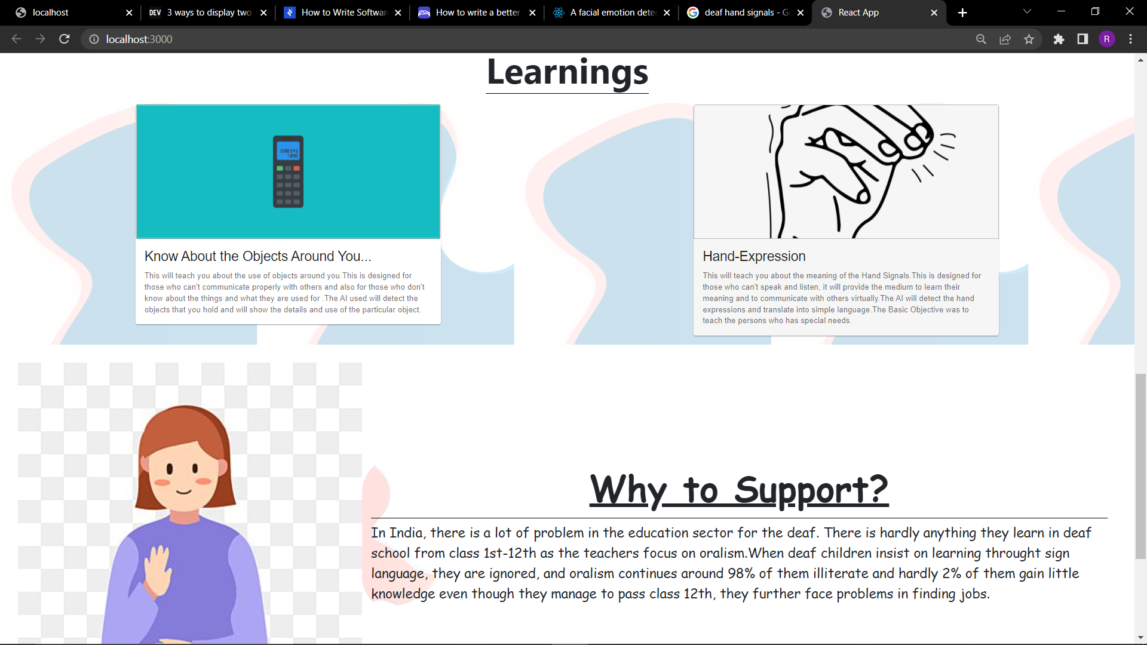
About us Section
Learnings and Why to Support Sections

Slide 8
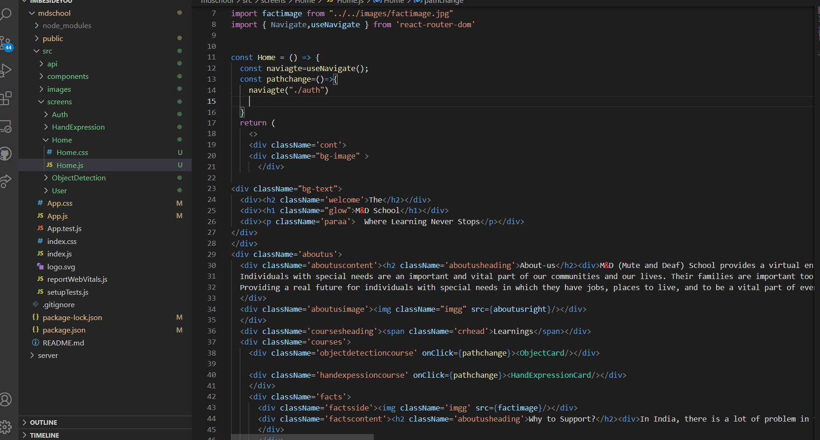
HOME PAGE CODE

Slide 9
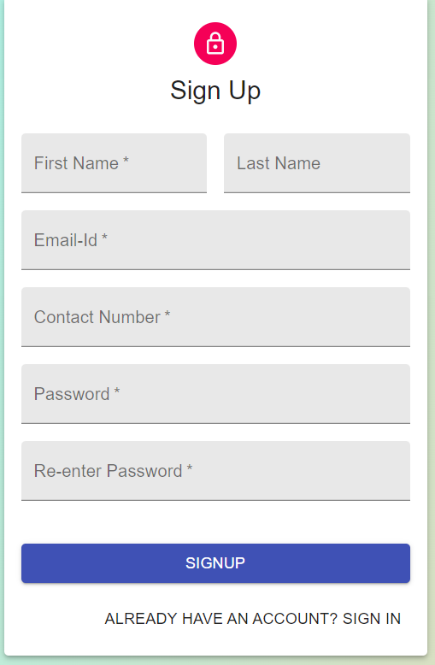
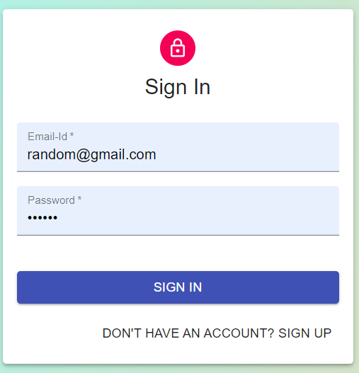
Login/Sign-up sECTION
To Track the Progress and for the privacy of the Individual user, each user has to make an account and for login, the user must remember its email and password.

Slide 10
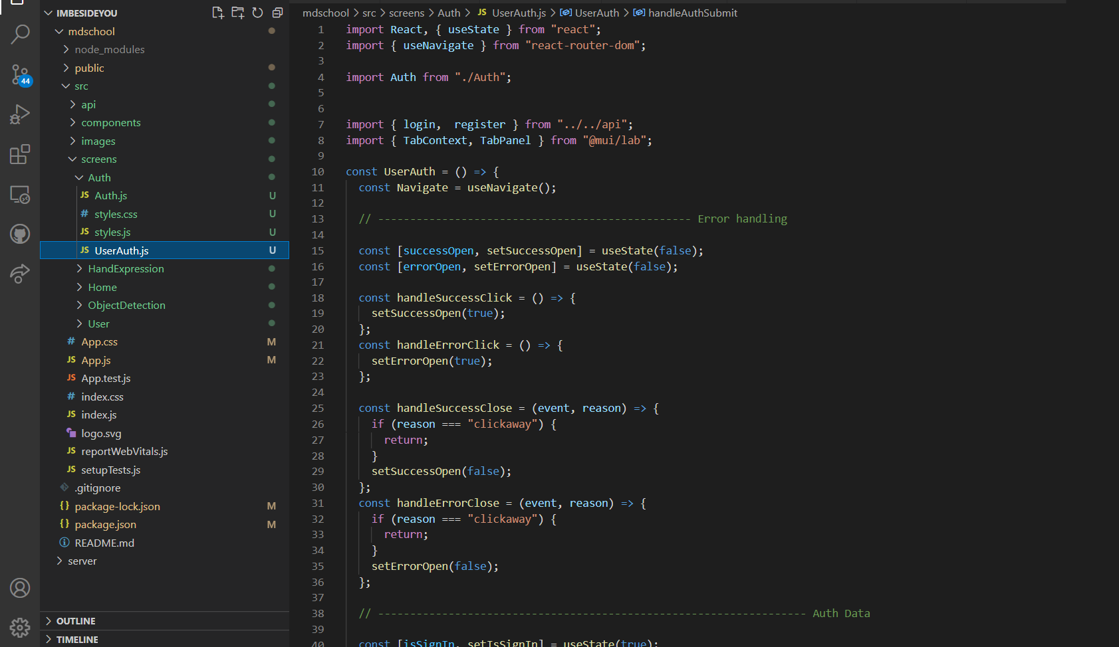
Signup/SIGNIN CODE

Slide 11
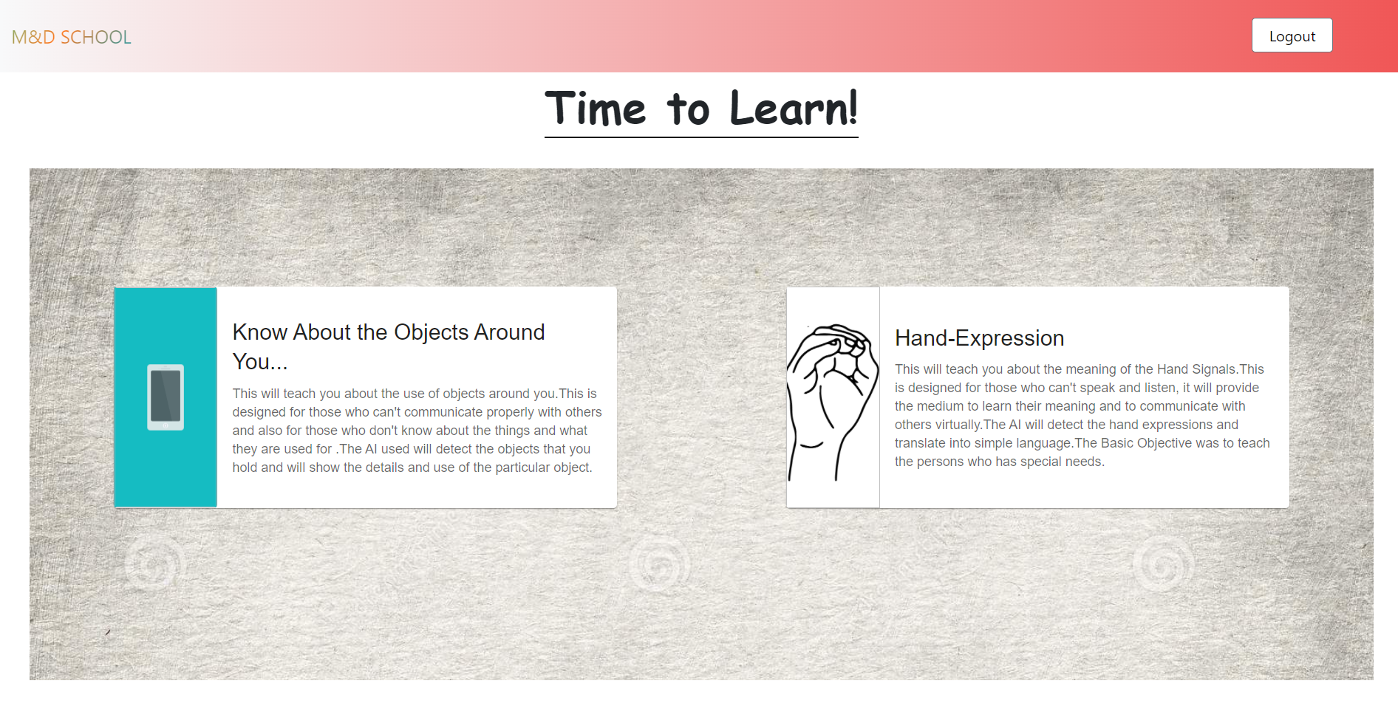
DashBoard
After login, the user interacts with the dashboards which consisted of the cards, Know about the Objects near you and Hand Expression Card for learning hand symbols.

Slide 12
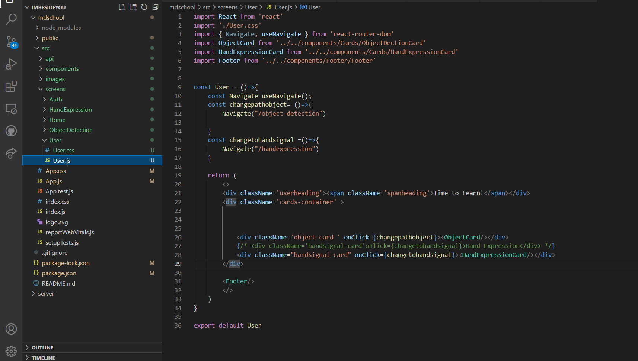
Dashboard code

Slide 13
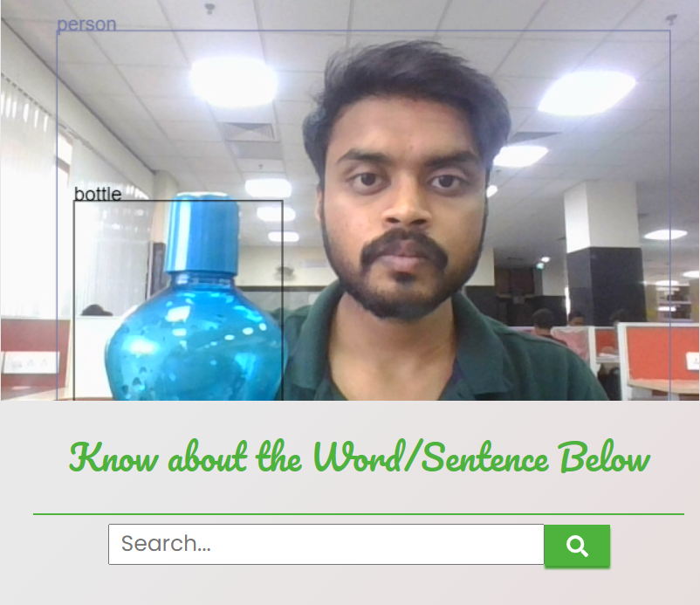
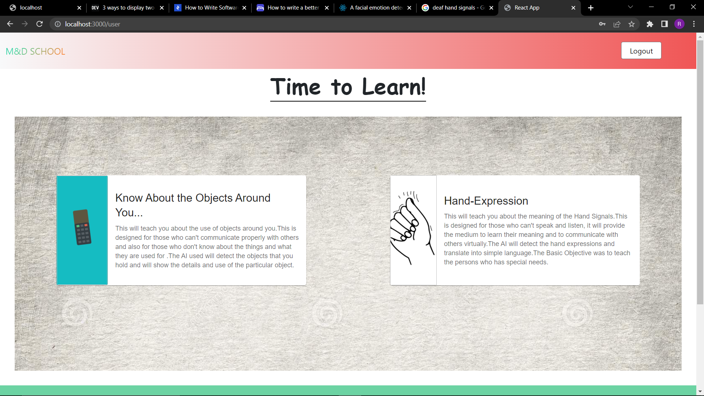
Know About the Objects NEAR YOU…
After clicking on the card of the “Know about the objects near you” ..the user will be redirected to the page where the AI Model of Object Detection Will be loaded and if the user wants to know about the particular object, the user have just to search the item in the search bar.

Slide 14
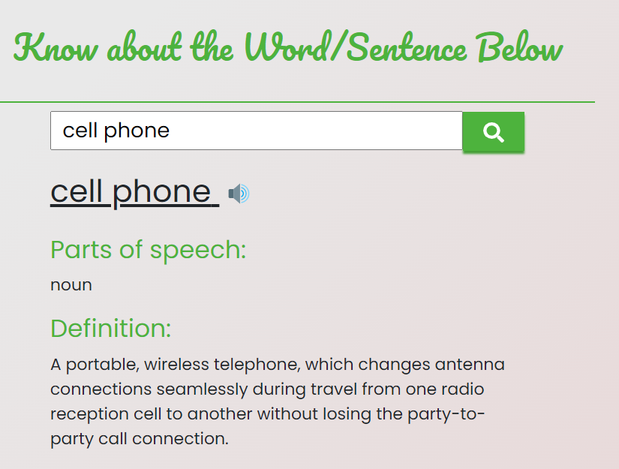
Search the Object in the Search Bar
The search bar provides the necessary information to the user along with examples so that the user can understand the word/sentence deeply.

Slide 15
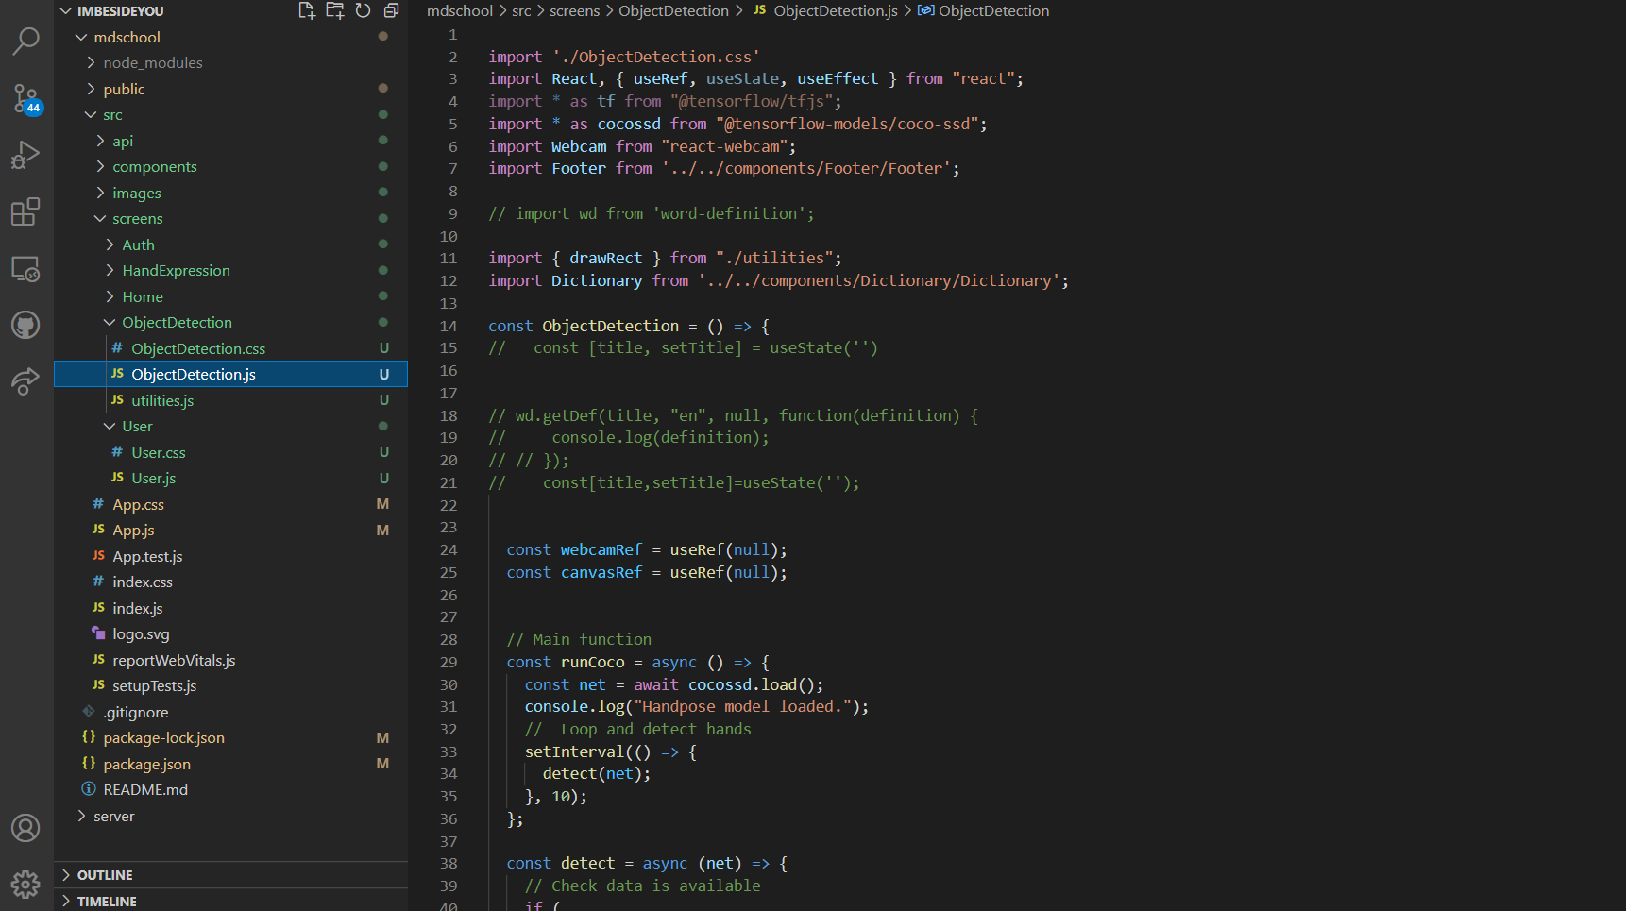
Object-Dectecton Component

Slide 16
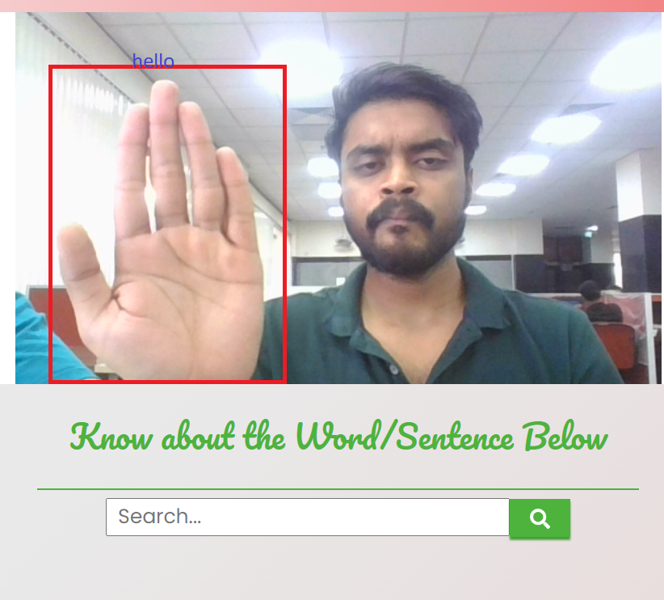
HandsIGNALS COMPONENT
Currently the handexpression model detects only 5 hand symbols the meaning of each is depicted in the rectangular box, for understanding and communicating this app can be used by the user.

Slide 17
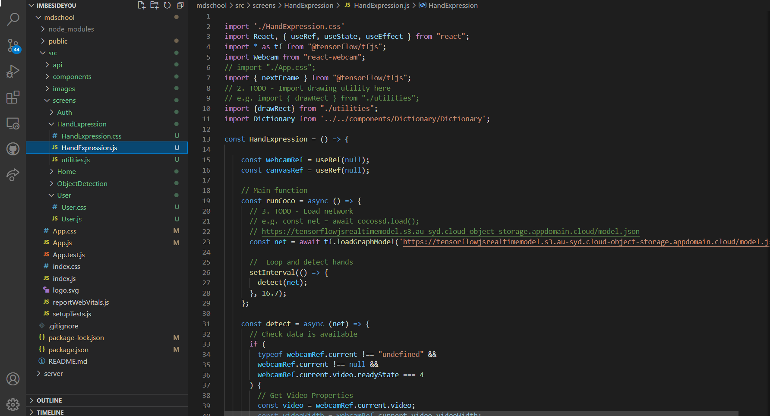
Handsignal code

Slide 18
Intergrating AI
For the Object Detection, An Open source, Face api was used from the tensorflowjs models which are available at :
As the AI was on real time it was integrated on the front end the reason for that is if we consider to integrate the AI at backend the data transfer would have to be fast as the input was a video and each frame of a video consists a multiple pictures the input amount would also go high.
As shown the detections was quick when the AI was integrated in the front-end part
For the Hand Expression the AI model was hosted on IBM cloud and api’s was used to interact with the ML model and by which each frame response was delayed and was not quick enough like the object detection model

Slide 19
Thankyou “Hope you liked it !”

